Slide 1
Normal Distribution

Slide 2
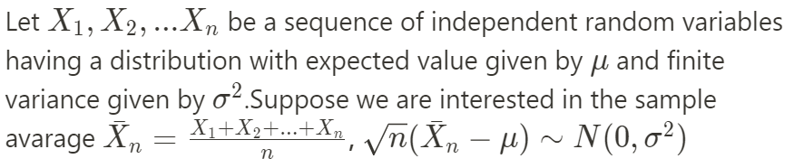
Central Limit Theorem (CLT)

Slide 3
Entropy Maximum
With specified mean and the variance and in real numbers, normal distribution has maximum entropy.
[a,b]->Uniform distribution
>0,mean->exponential distribution
We need two rules to specify a entropy maximum distribution

Slide 4

How to derive normal distribution
Random variable $X$ with sample points $x_{1},x_{2},…,x_{n}$.
Probability distribution function $f(x)$
Likelihood function $L(f)=\sum_{i=1}^{n}{f(x_{i})}$

Slide 5
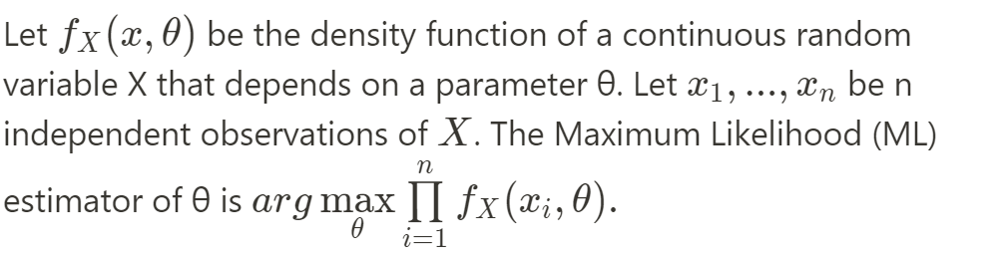
Maximum likelihood estimate

Slide 6
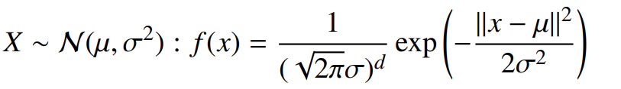
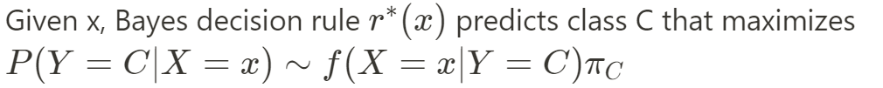
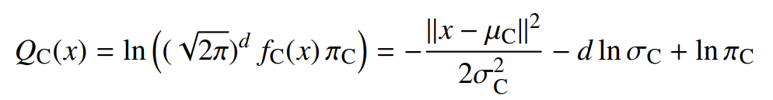

Gaussian Discriminant Analysis
Samples $x_{1},x_{2},…,x_{n}$.
For each class C, prior probablity ${\text{π}}_{C}\text{= }\text{P}\text{(}\text{Y}\text{ = }\text{C}\text{)}$
$r^{∗}\left(x\right)=class C that Q_{C}\left(x\right)=max⁡(Q\left(x\right))$
Maximum posterior probability

Slide 7
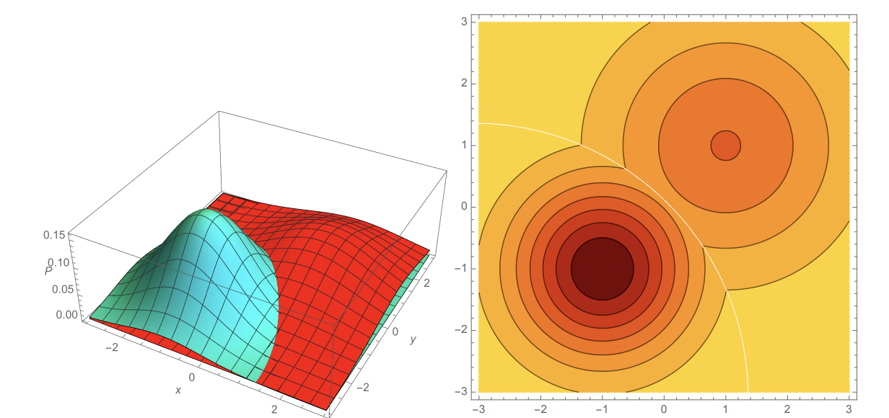
Gaussian Discriminant Analysis

Slide 8
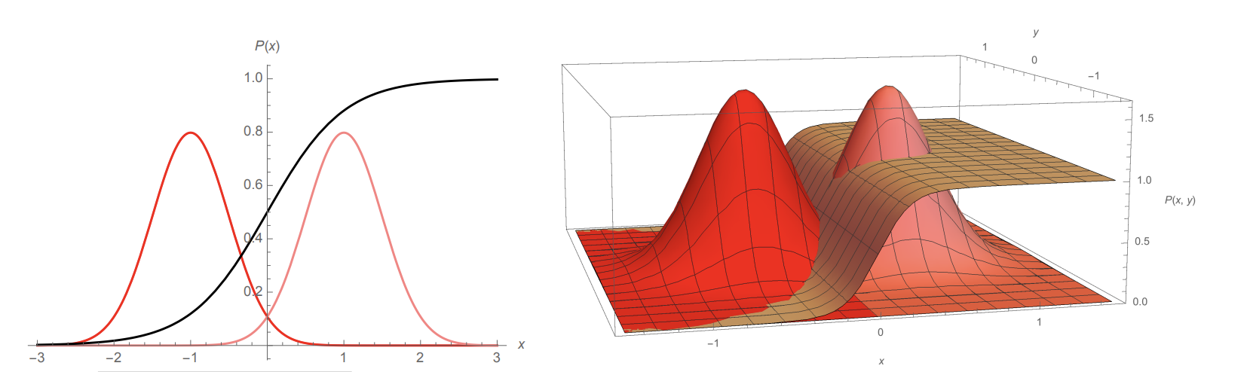
Linear Discriminant Analysis (LDA)

Slide 9
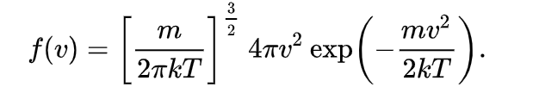
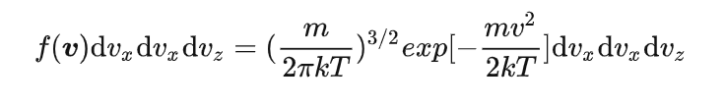
Maxwell–Boltzmann distribution

